Slide 1
Design Software For Woodworking
Dick Hoffmann
&
Rick Mannarino

Slide 2
Goals:
CAD Overview 3D, Drafting, Turning
SketchUp – What’s Possible Demo, warehouse
Pros & Cons SketchUp vs. Turbo CAD
Tour of SketchUp Controls
Creating a credenza w/SketchUp
What ifs – Credenza, Cherry Table
Available tutorials, YouTube videos, Libraries, downloading Sketchup
CAD Users Group? Library of Models
Only with practice and getting help using the software’s tutorial videos can you become proficient with the software!!

Slide 3
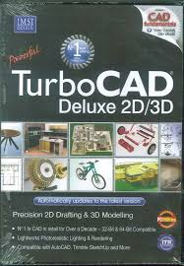
Woodworking Software
Lots of software
3D – SketchUp is Best
2D
15-20 Programs at various prices
Lots of Art Software
Drafting-Turbo CAD rated highest
Turning –
Wood Turner Pro
Miter Saw

Slide 4
SketchUp Demo
Jewelry Box
Axis, Measurements, Extrusion, Chamfer, round over, dimensions, viewing, materials
Turned Leg
Axis, profiling tools, guidelines,
followme

Slide 5
Software Overview
Sketchup
Free Version
Works well for most hobbyist
Downloads from the Internet
Pro Version: $495
More features (Cad-Cam interfaces)
Better Support
Turbo-Cad Deluxe 21
Cost $129
Primarily a drafting tool
Easy and Accurate for 2-D
Full Range of Features

Slide 6
Software Pros & Cons
SketchUp
TurboCad
Pros
Great for 3-D Visualization
Good for Stick & Panel
Free
Inference Points
Cons
Takes time to learn controls
Drawing orientation difficult
Hard to position objects
Limited drawing tools
Precision difficult
Printing options limited
Pros
Excellent precision, Snap to Grid
Easy to use
Full range of drawing tools
Good import/export options
Excellent print controls
Cons
Costs $129
No 3-D

Slide 7
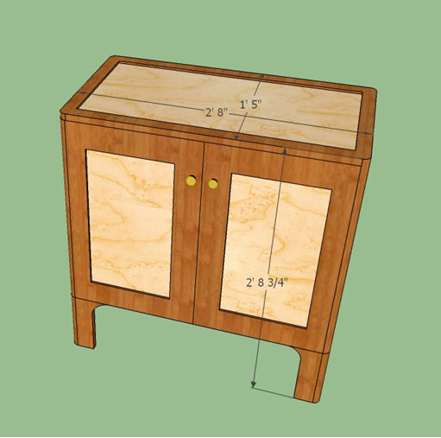
SketchUp Demo

Slide 8
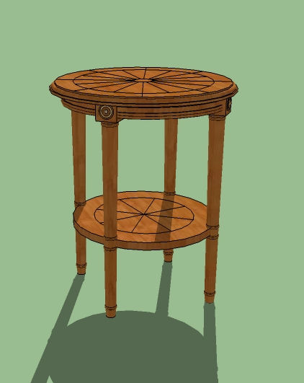
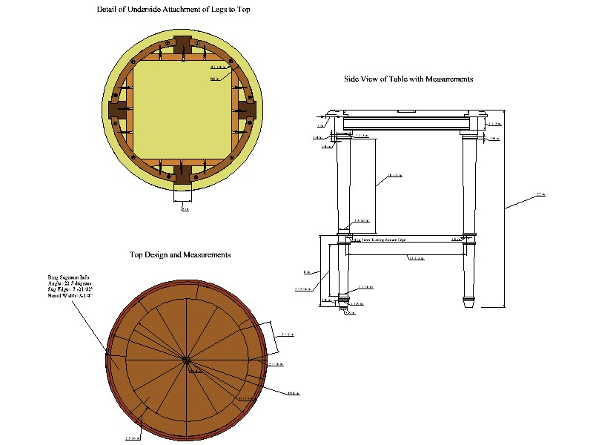
Small Round Cherry Table What If
Sketchup
TurboCad

Slide 9
Sketchup Resources
Sketch Up
Complimentary
Software Download
http://www.sketchup.com/
Help & Training
http://www.sketchup.com/learn/videos
https://3dwarehouse.sketchup.com/
Training
YouTube
Libraries
Fine Woodworking
Wood Magazine

Slide 10
Discussion & Question

